Slide 1
Unit 11 – A Modal verbs for speculating
Touchstone 3
A class by Mr. Jean Paul Quiñonez

Slide 2
What is a modal verb?
I can play any sports but soccer and I think I can dance too.
(abilities in the present time)
Will you go to clases tomorrow? There may be a fast test.
(future probabilities and predictions)
Your sister must study hard if she wants to pass this exam, it’s really tough.
(Duties in the present time)
Verbs for specific modes with specific uses

Slide 3
Modals for speculating
Nobody answers the phone, they all must be out. I’ll call later.
He doesn’t go out much. He must not be in the mood for being with Friends or something may be wrong.
We must be learning very well, we got the highest class score for 3 months in a row.
Must = future probability

Slide 4
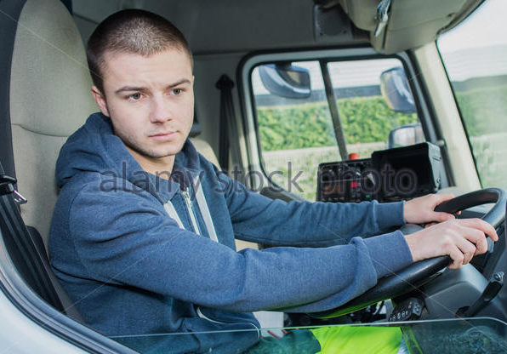
Some other modals
Who is that boy driving that truck? Is he old enough?
He can’t be older than 18, he looks really young.
We can be getting close to the conference place. I see lots of people going this way. Or we could get confused.
I could make a mistake, but I think you took my pen.
CAN/COULD= speculating possibilities or probabilities

Slide 5
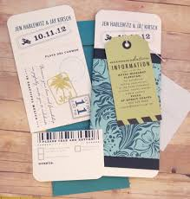
She might be arriving at any minute, I called her house and her daughter told me she left one hour ago.
That may be our ticket, but we have to confirm it.
They might call you later. I guess you impresed them.
Specific schedules and times in the future

Slide 6
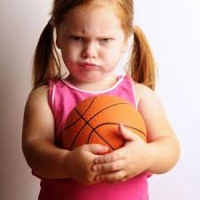
Negative speculations
She looks angry.
Or she must not want to talk to you. That might be all.
You might not choose well at first sight. Find out something else about that product.
Must not / might not
NO CONTRACTIONS USED

