Slide 1
Unit 12 – A Simple past passive
Touchstone 3
A class by Mr. Jean Paul Quiñonez

Slide 2
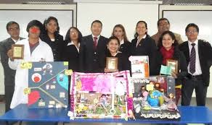
Active voice vs. Passive voice
University students make social projects every year.
(Students do the action – Active voice)
Social projects are made by students every year.
(Students do the action – Passive voice)
When using active voice, the subject is the principal on focus.
When using the passive voice, the subject isn’t the principal on focus. But it is still the subject.
We need transitive verbs to use passive voice

Slide 3
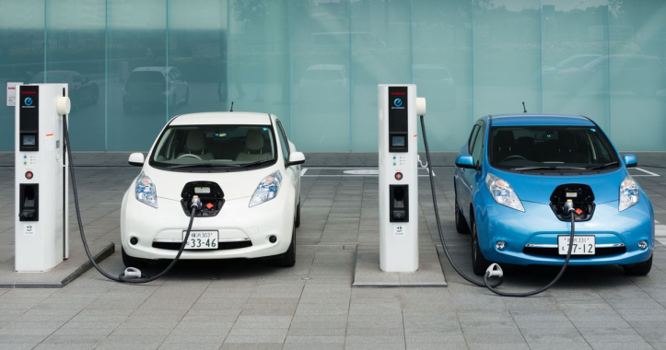
Simple past passive
A new planet was discovered in the solar system about 4 years ago.
Electric cars were launched in the commercial market last year.
My old house was sold last month for $ 45000.
Was / were + past participle is the key

Slide 4
Remember
My mother prepared breakfast very early today. (active)
Breakfast was prepared very early today. (passive)
Shigeru Miyamoto created the «Mario Bros.» game in 1985. (active)
The «Mario Bros.» game was created in 1985. (passive)
The focus of the sentences lays on the receiver (object) of the sentence
The object is STILL the object

Slide 5
Passive in written English
«Two thieves were arrested yesteday»
It happened when they were trying to rob a bank.
«A new electronic invention was presented in the university last month»
The students said that they worked on that project for over 4 years.
It is 5 times more commonly used in written than in spoken English

