Slide 1
Unit 7 – B Phrasal Verbs
Touchstone 3
A class by Mr. Jean Paul Quiñonez

Slide 2
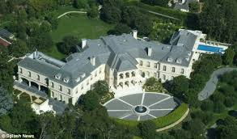
What is a phrasal verb?
I usually clean my house on Saturdays.
It is the regular routine of cleaning.
Last Saturday I cleaned up my bedroom and I found my lost shirt.
It was an exhaustive cleaning, more than the regular.
This month I haven’t cleaned off the house, there are tons of things we have to remove.
This has to be a very deep cleaning to remove things.
Normal verbs use A PARTICLE to have a specific meaning

Slide 3
Verbs with the particle UP
My parents didn’t grow up in the same country.
I usually get up at 6 a.m. every weekday.
Please, turn up the volume of the TV. I can’t listen to the dialog.
Up = a rising feature

Slide 4
Verbs with the particle ALONG
Susan and Jorge get along very well when they work in pairs.
Come along with me, the way will be fun together.
When we have singing classes, the teacher usually sings along with us.
Along = a company feature

Slide 5
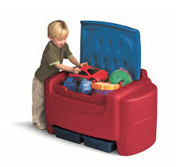
Verbs with the particle AWAY
After the war, the soldier went away with no fixed destination.
Put away your toys, they are all over the floor.
My mom told us to stay away from the fence because of the neighbor’s dog.
Away = some distance feature

Slide 6
Verbs with the particle BACK
We got back from that trip once we visited the museum.
Put your books back in your bag, we don’t need them anymore
If the dress doesn’t fit on you, you can send it back to the store.
Back = similar to return

Slide 7
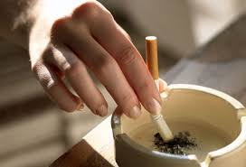
Verbs with the particle OUT
Before you enter the room, put out your cigarette please.
I want to find out who took that photo.
That idea worked out in order to solve that problem, but it doesn’t work out for every problem.
Out = similar to not in place

Slide 8
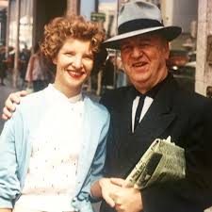
Some phrasal verbs use prepositions:
We get along very well in school.
I get along with you very well in school.
My mother usually goes out on Saturdays.
My mother usually goes out with my father on Saturdays.
You must get out.
We must get out of this place.

Slide 9
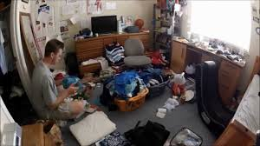
In general
There are hundreds of phrasal verbs we can know and learn how to use, the primordial use is to give specific characteristics for a description
I have to clean my room. (just sweep and dust)
I have to clean up my room. (Doing some intensive cleaning)
I have to clean off my room. (Clear it from every waste)

