Slide 1
Unit 8 - A Wishes and Imaginary situations
Touchstone 3
A class by Mr. Jean Paul Quiñonez

Slide 2
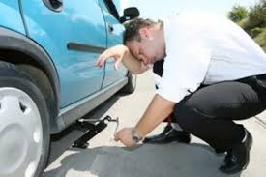
Wish
I wish I had enough money to buy a new car, but I don’t have it.
We wish you came here for Christmas. I would be great to have the family together.
Mom wishes she could cook that dish, then my father would enjoy it more frequently.
Wish + a sentence in simple past

Slide 3
Wish and the verb BE
Wish + were for all subjects
NEVER use was
I wish life were not so complicated.
You wish your sister were here. Maybe she could come by next holidays.
My parents wish I were a doctor, but I love art instead.

Slide 4
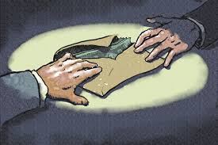
Negative wishes
People wish their governmet weren’t so corrupt.
Your father wishes I weren’t your best friend, but he can’t change that.
I wish you didn’t leave today. I’m going to miss you a lot.
Wish + a negative sentence

Slide 5
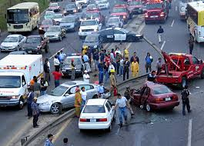
Hypotethical situations
If people obeyed traffic rules, there would be less accidents on the streets.
If my father had more free time, we would go out more often.
My parents would be happier if they passed more time together.
If + simple past sentences
Would for resulting clauses

Slide 6
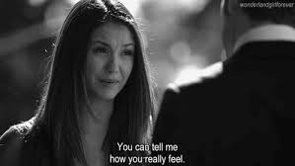
Hypothesis and the verb BE
If clauses use were
NEVER use was
I this neihbourhood were safer, we wouldn’t have to move.
I could spend some time with friends if I weren’t so busy with this university project.
If your sister were here, you could tell her about how you feel.

Slide 7
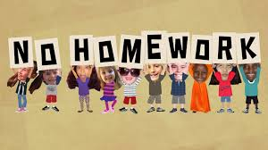
Negative hypothetical situations
If my sister didn’t move house, my mother wouldn’t be so sad.
I would be really glad if my teachers didn’t give me homework.
If you didn’t lose your temper, you wouldn’t have so many problems with others.

Slide 8
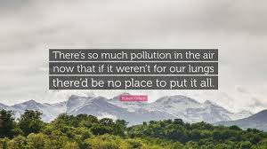
Joining wishes with hypothesis
I wish I could stop smoking. If I stopped smoking I would be able to run a marathon.
My father wishes he had a different job. If he had a better job, he would spend some more time with us.
We wish there weren’t so much pollution. If there weren’t so much pollution, we could enjoy the nature more.

