Slide 1
Unit 8 - B Asking about Imaginary situations
Touchstone 3
A class by Mr. Jean Paul Quiñonez

Slide 2
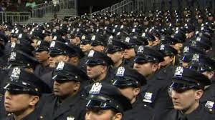
Hypothetical situations
If there were more police officers on the streets, there would be less criminal situations.
If you didn’t have to go to work early today, you wouldn’t have to get up earlier than usual.
If I left university, I wouln’t have a chance to have a fine job.
Wish + a sentence in simple past

Slide 3
Questions
The resulting clause causes the question
What would you buy first if you were a millionaire?.
I would buy a house for my family.
Where would you travel if you had a private Jet at your service?
I would travel all over the world.

Slide 4
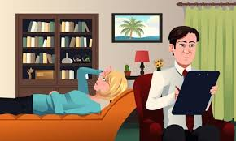
Starting with If
If you lived in a different country What profession would you decide to have?
I’d be a psychologist so that I could learn people’s ways.
If you were young again Who would you choose as your best friend?
I guess I wouldn’t take another decission on who my best friend would be.
Wish + a negative sentence

Slide 5
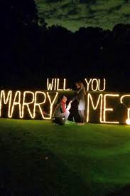
Simple questions
Would you buy a new cell phone for me if I asked you for it?
No, I wouldn’t. I’d have to think it over.
If Carolina proposed you matrimony right now, would you accept?
Yes, I would. But she wouldn’t tell me that now.
You can use the contraction ‘d or wouldn’t for responses

