Slide 1
Unit 6 – A Talking about the future
Touchstone 3
A class by Mr. Jean Paul Quiñonez

Slide 2
Future with will
I think I will go and buy a soda, it’s getting hot in here.
Will you go for that bread? Breakfast is ready.
I’ll go in a moment mom.
I’ll take two days off if the project is accepted. I need some rest.
Decissions made at the moment of speaking

Slide 3
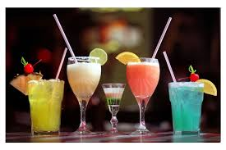
Future with will or going to
Factual information or predictions based on what you know
I’m going to finish my report in two hours, then I will get myself a huge hamburger.
Are you going to come to our party? It’s already started.
I’ll be there in 10 minutes, I’m going to lock all my doors.
What are you going to do right after classes are over?
We’ll go to my place for some drinks.

Slide 4
Present Progressive for future
What is your family going to do for next Christmas?
We have already made plans, we’re traveling to our grandparents’ on Monday the 23rd .
Is Maria going to travel to Jamaica for that business meeting?
Sure, she is. She is booking her plane tickets right after our meeting tonight and she is departing Wednesday at 6 a.m.
Decissions made or fixed plans or schedules

Slide 5
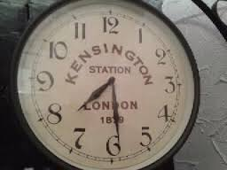
Simple present for future
We have an important exam at school at 7.30 sharp tomorrow.
Your bus arrives at 6 o’clock, right?
Of course, you have to be there 20 minutes earlier.
We have dinner at 8 o’clock, whether you are or not.
Specific schedules and times in the future

Slide 6
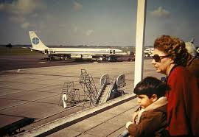
Blending future expressions
What are you going to do next Saturday?
I’m not sure. Maybe I will stay home unless my parents take me out for a walk.
What time is your flight arriving?
It arrives at 6.45 sharp. I’m looking forward to being back there.
The class starts at 8 a.m. tomorrow. I’m going to sleep early so that I can get up early and be on time.
Time expressions are important

