Slide 1


Unit 5-B
Too – Enough
Touchstone 3
A class by Mr. Jean Paul Quiñonez

Slide 2
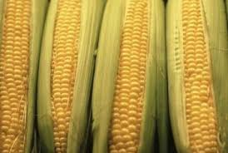
An adverb
We don’t have any apples on the table for dessert.
There are many captive animals in the zoo.
Would you like to drink some soda with your pizza?
Sure, I’d love some coke.
I want to buy much corn so that we can prepare a lot of «tamales».
These adverbs determine QUANTITY.

Slide 3

Too with adjectives
We use TOO before an adjective to show a negative idea or meaning
It was too late for you to return home, that’s why I got angry.
You are too indulgent with the tenants, it’s been 4 months they don’t pay the rent.
TOO
for negative ideas

Slide 4
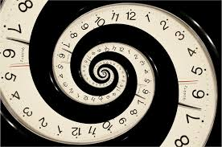
Too with adverbs
The taxi driver drove too slowly, so we arrived too late.
I didn’t finish the exam because the time passed too quickly.
The prime minister responded too critically before the senator’s accusations.
An adverb modifies the result of an action, it means modifies a verb

Slide 5
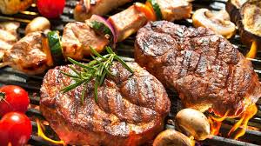
Too much
There is too much water in the bucket, it may overflow.
My father prepared too much orange juice, so we have to throw it now.
I can’t eat any more, too much meat might cause me inidigestion.
When there’s no quantity for uncountable nouns (excess)

Slide 6

Too many
There are too many cars downtown, the traffic is chaotic.
That lady has too many shopping bags, we should help he carry them to the taxi.
I don’t want to go there, too many people make me stressed out.
When there’s no quantity for countable nouns only in plural (excess)

Slide 7
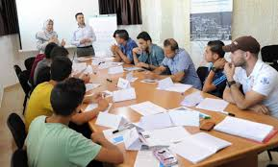
As pronouns
The food was really great, but I had too much.
I don’t like to see animals in captivity, I saw too many.
It’s good to have many ideas, but the focus group produced too many. We can’t decide fast.
At the end of a sentence

Slide 8
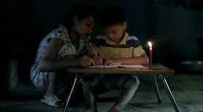
Enough with nouns
I don’t have enough time to work on this project.
There isn’t enough light in the room to study in it.
Life gives you enough chances to make it better every time
Enough + noun

Slide 9
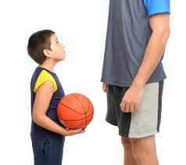
Enough with adjectives
Your speech was good enough in order to convince the president to give us that money.
Life was comfortable enough to have big families 50 years ago.
My father wasn’t tall enough when he was in high school. He couldn’t be part of the basketball team.
Adjective + enough

Slide 10
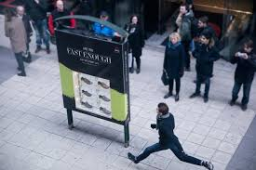
Enough with adverbs
You are not running fast enough. We’ll never get there on time.
My mother drives carefully enough so that we can arrive home safely.
That man spoke honestly enough to believe in what he said.
Adverb + enough

Slide 11
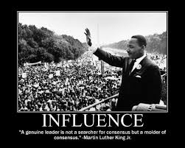
Enough with verbs
I think mom cried enough for her little cats that dissapeared last night.
Lucia eats enough to keep fit.
Martin Luther King Jr. spoke enough to get people to work, he influenced with his actions more.
I had enough.
At the end of a sentence as a pronoun

Slide 12



